Slide 1
Biomedical, Clinical and Translational Research Data Life Cycle: Part 2
BDK01-3 | Introduction to Biomedical Big Data Science
William Hersh, MD | Department of Medical Informatics & Clinical Epidemiology
Oregon Health & Science University

Slide 2
Challenges

Slide 3
Challenges to biomedical, clinical, and translational research
Value
Funding
Infrastructure
Data capture and analysis
Trust and privacy

Slide 4

Increasing value, reducing waste – series in The Lancet
Figure from Macleod, MR, Michie, S, et al. (2014). Biomedical research: increasing value, reducing waste. Lancet. 383:101‐104.

Slide 5
Rescuing US research from “systemic flaws”
Era of unsustainable growth has ended, but system has not adapted, resulting in:
Hypercompetition – grant funding success has decreased from 30% to low teens, encouraging shorter-term and incremental proposals
Excessive demands on scientist time for writing grant proposals, serving as reviewers, meeting regulatory requirements, etc. and less time for “reflective thinking”
Excess number of trainees in face of reduced opportunities – only 20% of PhD graduates will attain faculty positions
Has created a “generation at risk” for young scientists, especially clinician-scientists; solutions include:
Create predictable and sustainable funding
Broaden career paths for trainees
Mentoring by established scientists
(Alberts, 2014) (Daniels, 2015) (Yin, 2015)

Slide 6
Infrastructure
Many healthcare organizations, even academic health centers, do not always integrate clinical and research informatics well
Many people, organizational, and leadership challenges for academic health centers wanting informatics support for clinical research
Higher satisfaction for support for institutions having a biomedical informatics academic unit
Resources can be difficult for researchers to find, resulting in information overload, missed opportunities, and needless duplication
Resources not uniquely identified, undermining reproducibility of research
(Katzan, 2012; Marsolo, 2012; Murphy, 2012; Gelijns, 2013) (Payne, 2013) (Bhavnani, 2012) (Vasilevsky, 2013)

Slide 7
Data capture and analysis
Recall problems discussed in context of data analytics
Data quality and accuracy is not a top priority for busy clinicians
Patients get care at different places
Standards and interoperability – mature approaches but lack of widespread adoption
Much data is “locked” in text
Quantity can be overwhelming – average pediatric ICU patient generates 1348 information items per 24 hours
(Hersh, 2014) (de Lusignan, 2005) (Bourgeois, 2010; Finnell, 2011) (Kellermann, 2013) (Hripcsak, 2012) (Manor-Shulman, 2008)

Slide 8
Data capture and analysis (cont.)
Data entry
Clinicians prefer narratives; research requires structure
Data input from any type of device presents challenges to workflow, accuracy, etc.
Data quality assessment still a developing science
Patient recruitment can be aided by clinical decision support rules, although can also cause alert fatigue
Clinical trial eligibility is not always precise enough for computer-based representation
Even in research-oriented healthcare organizations, EHR data across health systems may be missing, erroneous, uninterpretable, and inconsistent
(Rosenbloom, 2011) (Kahn, 2012; Weiskopf, 2013) (Embi, 2005; Köpcke, 2014) (Embi, 2012) (Ross, 2010) (Bayley, 2013)

Slide 9
Trust and privacy
Patients must have trust that their best interests will be looked after – must manage relationships among researchers, institutions, and industry
HIPAA Privacy Rule may be impeding research without improving privacy for the patient
Patients are willing to allow use of their data when they perceive their interests are respected
Survey of US adults found patients amenable to secondary use of their EHR data; more toward research than quality or marketing uses
Breast cancer patients expressed low level of concerns about privacy of data but do want it protected
Employees of academic medical centers are willing to donate their data for clinical research if de-identified and certain categories of sensitive data redacted
(Yarborough, 2002) (Nass, 2009) (Grande, 2013) (Rogith, 2014) (Hurdle, in preparation)

Slide 10
Solutions

Slide 11
Solutions
Clinical trials and studies management
Integrated data repositories and results from them
Emerging themes from CTSA for clinical research IT infrastructure
Other innovations

Slide 12
Clinical trials and studies management
Clinical Data Interchange Standards Consortium (CDISC) – standards to support electronic acquisition, exchange, submission, and archiving of clinical and non-clinical study data and metadata

Slide 13
Integrated data repositories (IDRs)
HMO Research Network (HMORN)
Scalable Collaborative Infrastructure for a Learning Health System (SCILHS), including
Informatics for Integrating Biology and the Bedside (i2b2)
Shared Health Research Information Network (SHRINE)
Other IDRs
Biobanking
Common themes across CTSA and other programs

Slide 14
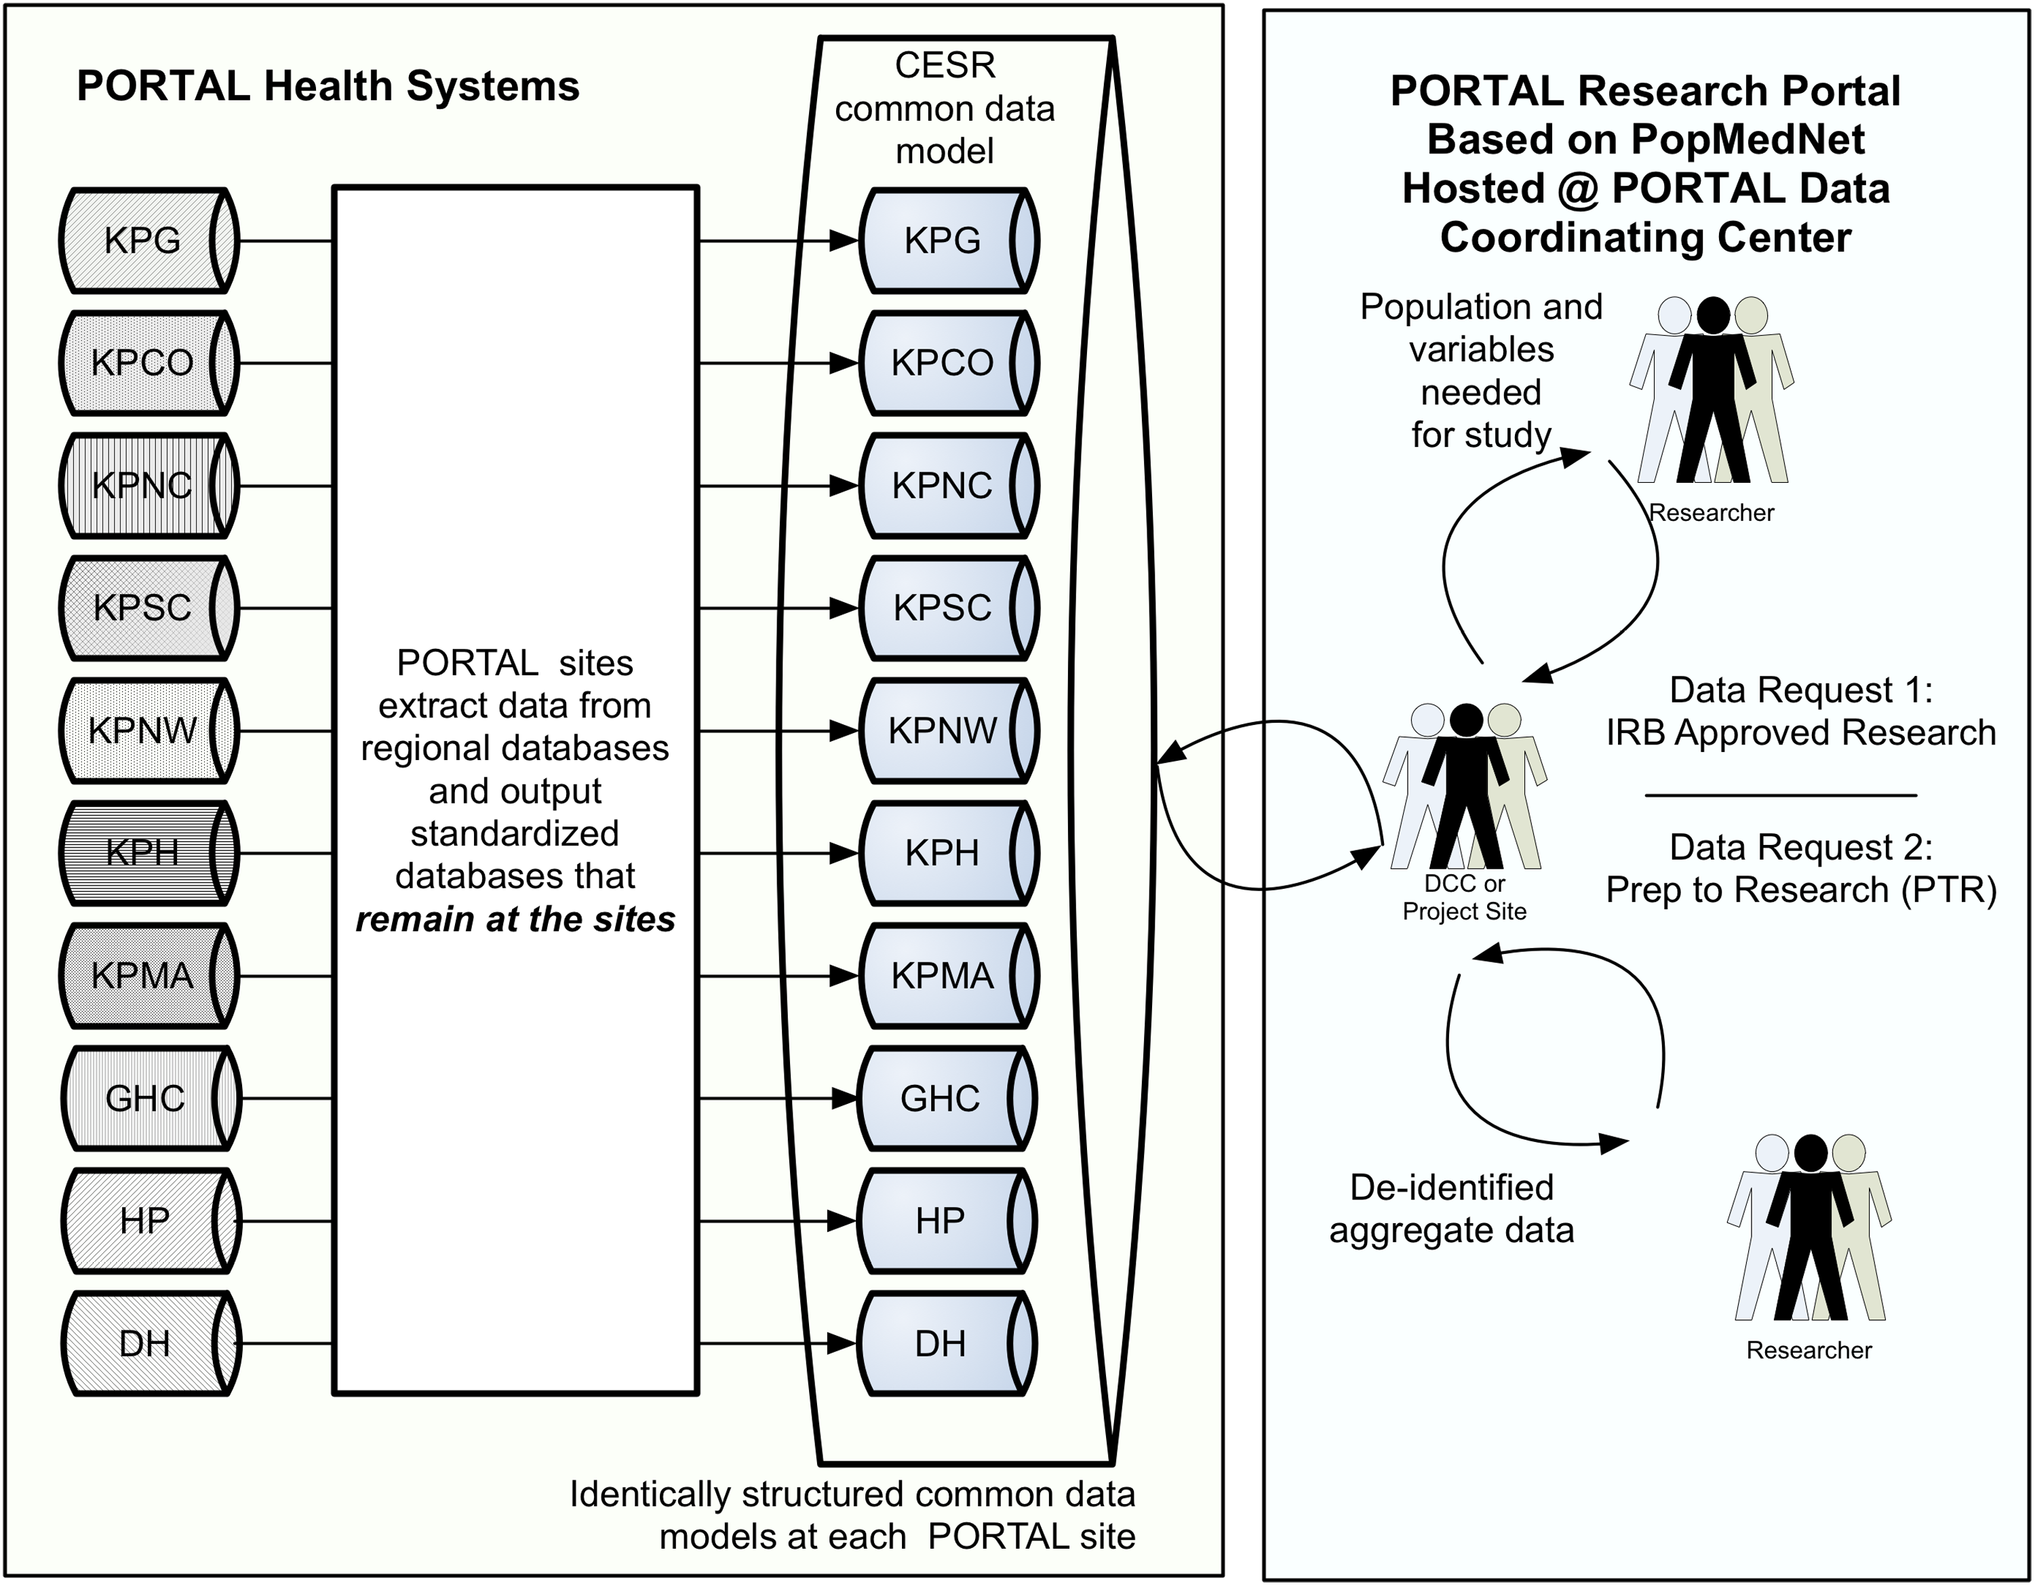
HMO Research Network (HMORN)
Virtual Data Warehouse (VDW) mapped disparate clinical data systems of HMOs to a common data model
Acknowledged non-interoperability of inter-institutional data
Human layer added value with security, IRB, etc.
Under PCORNet, evolving to Patient Outcomes Research To Advance Learning (PORTAL)
(Hornbrook, 2005) (McGlynn, 2014)

Slide 15
Scalable Collaborative Infrastructure for a Learning Health System (SCILHS)
PCORNet project bringing together previous projects
i2b2 – scalable informatics framework to bridge clinical research data with basic science data to better understand the genetic bases of complex diseases
Software framework is “hive” of interfacing components
SHRINE – federated query system across i2b2 data sources
SMART Platforms – substitutable apps
Indivo – PHR platform creating channel between researchers and patients
(Murphy, 2011; Kohane, 2012) (Weber, 2009; McMurry, 2013) (Mandl, 2012) (Mandl, 2007; Adida, 2010)

Slide 16
SHRINE i2b2 query tool
Image from Murphy, SN, Weber, G, et al. (2011). Serving the enterprise and beyond with informatics for integrating biology and the bedside (i2b2). Journal of the American Medical Informatics Association. 17: 124-130.

Slide 17
Some other IDR projects
DARTNet – early effort standardizing EHR data for research in Colorado and vicinity
US Food and Drug Administration (FDA) Mini-Sentinel project – focused on surveillance of safety for marketed medical products
Challenges in harmonizing data, e.g., lab test results
UC-Rex – partnership of five University of California CTSA programs to allow query of EHRs for research using SHRINE/i2b2
Now partnered with Veteran’s Administration (VA) in pSCANNER PCORNet project
(Pace, 2015) (Platt, 2012) (Raebel, 2014) (Ohno-Machado, 2014)

Slide 18
Other IDR projects (cont.)
NIH Biomedical Translational Research Information System (BTRIS) – data repository for all patients treated at NIH, with standardized terminology and query tools
New York City Clinical Data Research Network – PCORnet project bringing together numerous health systems
Commercial examples
Insight – real-time patient data from >112K clinician users of PracticeFusion EHR
Explorys – healthcare organizations provide data and receive analytics in return
Health Catalyst – another data warehousing and analytics service
(Cimino, 2014) (Kaushal, 2014)

Slide 19
Biobanking
Biobanking – develop tissue repositories connected to clinical information and made available to clinical researchers; efforts include
UK Biobank
Europe
Mayo Clinic
Numerous infrastructure challenges
(Allen 2012; Allen, 2014) (Zielhuis, 2012) (Olson, 2013) (Prokosch, 2010)

Slide 20
Examples of research results from IDRs
Relationship of childhood obesity to hyperglycemia in pregnancy
Using data in VDW for nearly 10,000 patients, found association between hyperglycemia in pregnancy and subsequent childhood obesity
“Replication” of clinical trials results by using techniques and measures, e.g., prior event rate ratio (PERR)
Shown to replicate results of Women’s Health Initiative (Tannen, 2007) and hypertension studies
Query of research database in care of pediatric lupus patients when no published literature existed
Most effective initial therapy for hypertension, e.g., fixed dose combinations of medications versus individual medications
(Hillier, 2007) (Tannen, 2009) (Tannen, 2007) (Tannen, 2008) (Frankovich, 2011) (Bronsert, 2013)

Slide 21
Common CRI themes among CTSA informatics programs
Web portal to integrate research activities, people, etc.
Informatics services and consultation for clinical and translational investigators
Data warehousing for clinical, laboratory, and/or specimen data
Longer-term but more difficult goal: data sharing across institutions
Facilitating collaboration and translation
Educational programs for clinical and translational researchers
Some programs also focused on education for informaticians

Slide 22
Contents of IDRs in CTSA programs
Figure from MacKenzie, SL, Wyatt, MC, et al. (2012). Practices and perspectives on building integrated data repositories: results from a 2010 CTSA survey. Journal of the American Medical Informatics Association. 19(e1): e119-e124.
(MacKenzie, 2012)

Slide 23
Some other informatics innovations to support clinical research
Research Electronic Data Capture (REDCap) uses metadata to create simple data capture forms and stores data securely for researchers
Mobile technologies to support data capture and use, especially in developing countries
Integrating EHR data with self-reported patient data
Up to 75% of data usable for research
Growing interest in research based on electronic patient-reported outcomes (ePRO) in clinical trials
(Harris, 2009) (Lang, 2011; Rajput, 2012) (Cascade, 2012) (Coons, 2014)

Slide 24
“Vanderbilt approach” to secondary use of clinical data
Figure from Danciu, I, Cowan, JD, et al. (2014). Secondary use of clinical data: the Vanderbilt approach. Journal of Biomedical Informatics. 52: 28-35.

Slide 25
Toward the future
Addressing challenges
Governance
Data standards and interoperability
Architecture and data exchange
Privacy and ethical issues
Methods
Incorporating patient-reported outcomes
Desiderata for IDRs
(PCORI, 2013) (Huser, 2013)

Slide 26
Thank you
Please download the resource list with useful links from the “Resources” tab in the upper right of the player.
This course was made possible under a grant from the NIH (# 1R25GM114820-01)

